Slide 1
Congestion Window

Slide 2
Program 3:
Simulate an ethernet LAN using n nodes &set multiple traffic nodes & plot congestion window for different source/destination

Slide 3
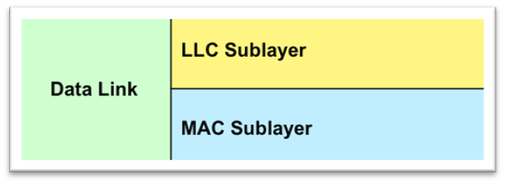
Ethernet:
Ethernet is a technology that connects wired local area networks (LANs) and enables the device to communicate with each other through a protocol which is the common network language.
Ethernet is a weird LAN
It is a protocol present in the data link layer
The data link layer consists of two sub layer:
Media access control (MAC)
Logical link control (LLC)

Slide 4
Congestion:
Network congestion is the reduced quality of service that occurs when a network node or link is carrying more data than it can handle.
CWND and RWND
Congestion Window (CWND) : cwnd is a TCP state variable that limits the amount of data the TCP can send into the network before receiving an ACK.
Receiver Window (RWND): rwnd is a variable that advertises the amount of data that the destination side can receive.
Together , the two variables are used to regulate data flow in TCP connections, minimize congestion, and improve network performance

Slide 5
Slow start and congestion avoidance in TCP
In slow start congestion control, TCP increases the windows size rapidly to reach the maximum transfer rate as fast as possible. This self-imposed window size increases as TCP confirms the networks ability to transmit the data without errors, however, this can only go up to a maximum advertised window (RWND)
In this scenario, the sender uses two variables:
Congestion window with an initial value of one maximum segment size (MSS)
The slow start threshold value (ssthresh) with an initial value equal to the receiver window.
The congestion window increases exponentially during congestion control, and lineally during the congestion avoidance. Sslow start occurs when cwnd < ssthresh and congestion avoidance occurs when cwnd>=ssthresh
Whenever a packet has been lost or we received 3 duplicate ACK, then the congestion has dropped to zero

Slide 6
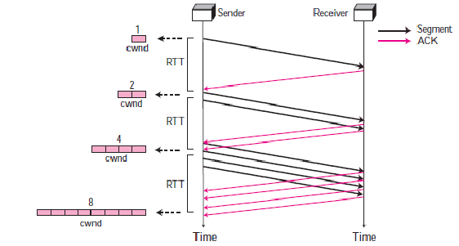

Slide 7
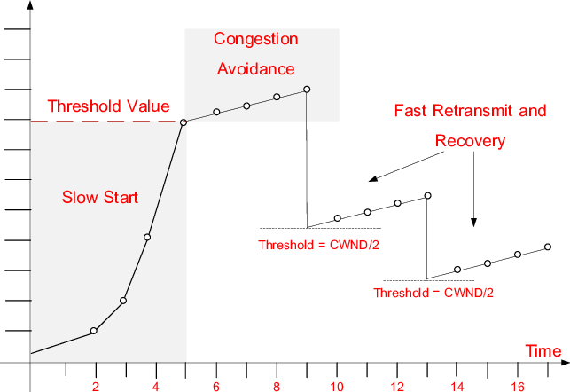

Slide 8


